Slide 1
Strings

Slide 2
To Be Covered
What is String
Memory Representation
Pooling
Why String is Immutable
String Functions
String Builder
String vs StringBuilder

Slide 3
What is String
▪ Strings, which are widely used in Java programming, are a sequence of characters.
Java programming language, strings are treated as objects.
Creating String objects:
String Literal:
String s = “chandu”;
Using new keyword:
String s = new String(“Java”);

Slide 4
How to create a string
String Literal:
String s = “chandu”;
Using new keyword:
String s = new String(“Java”);

Slide 5
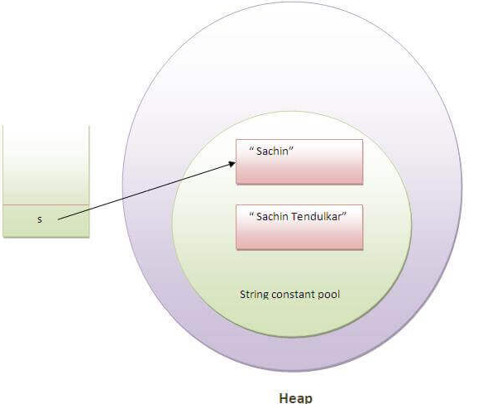
Memory Representation
String s = “sachin”;

Slide 6
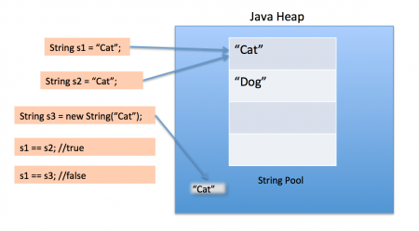
Pooling
String s1 = “cat”;
String s2 = “cat”;

Slide 7
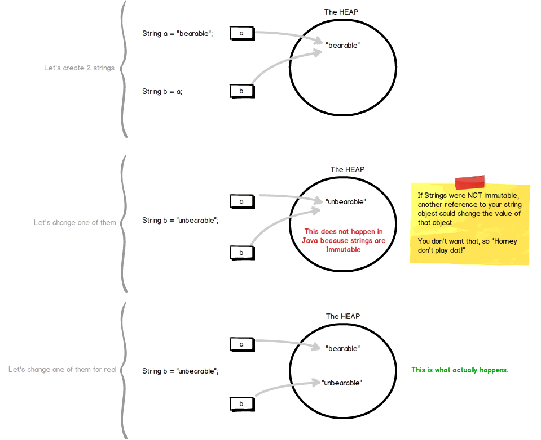
Why String is Immutable
If strings are mutable another
reference to your string object
could change the value of that
object

Slide 8
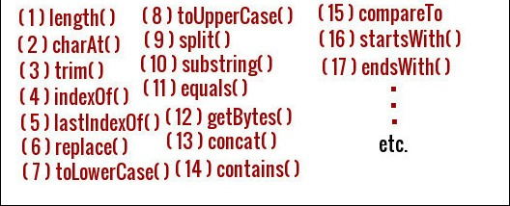
String Functions

Slide 9
String Builder
Java StringBuilder class is used to create mutable (modifiable) string.
it is non-synchronized.
It is available since JDK 1.5.
Creation of String Builder Object:
StringBuilder sb=new StringBuilder("Hello ");

Slide 10
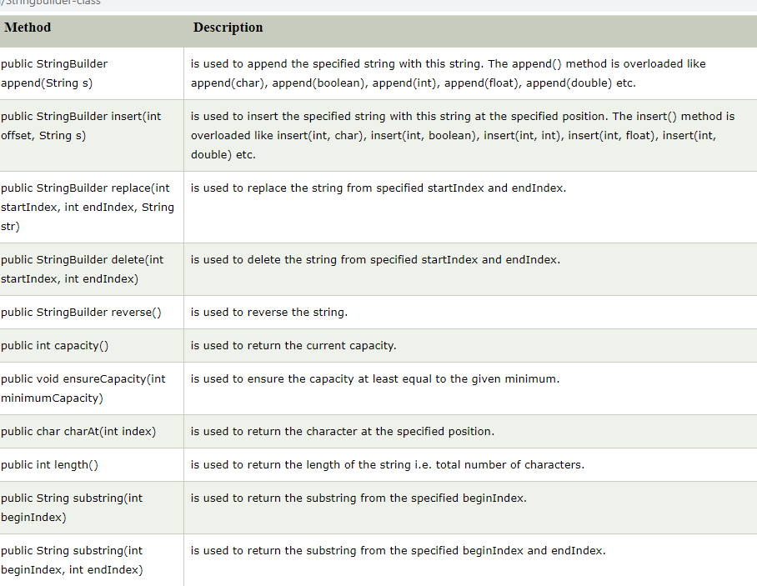
StringBuilder Functions

Slide 11
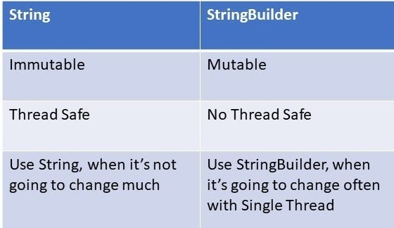
String vs StringBuilder

Slide 12
Thank You

